Slide 1
Data Visualizations
File created on: 12/18/19 2:08:10 PM EST

Slide 2
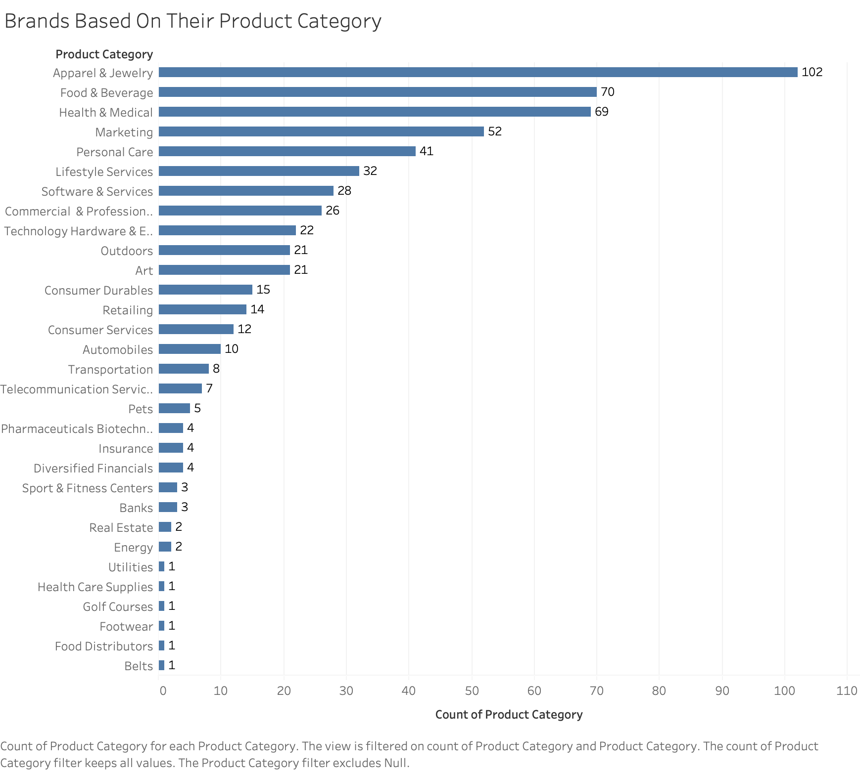

Slide 3


Slide 4
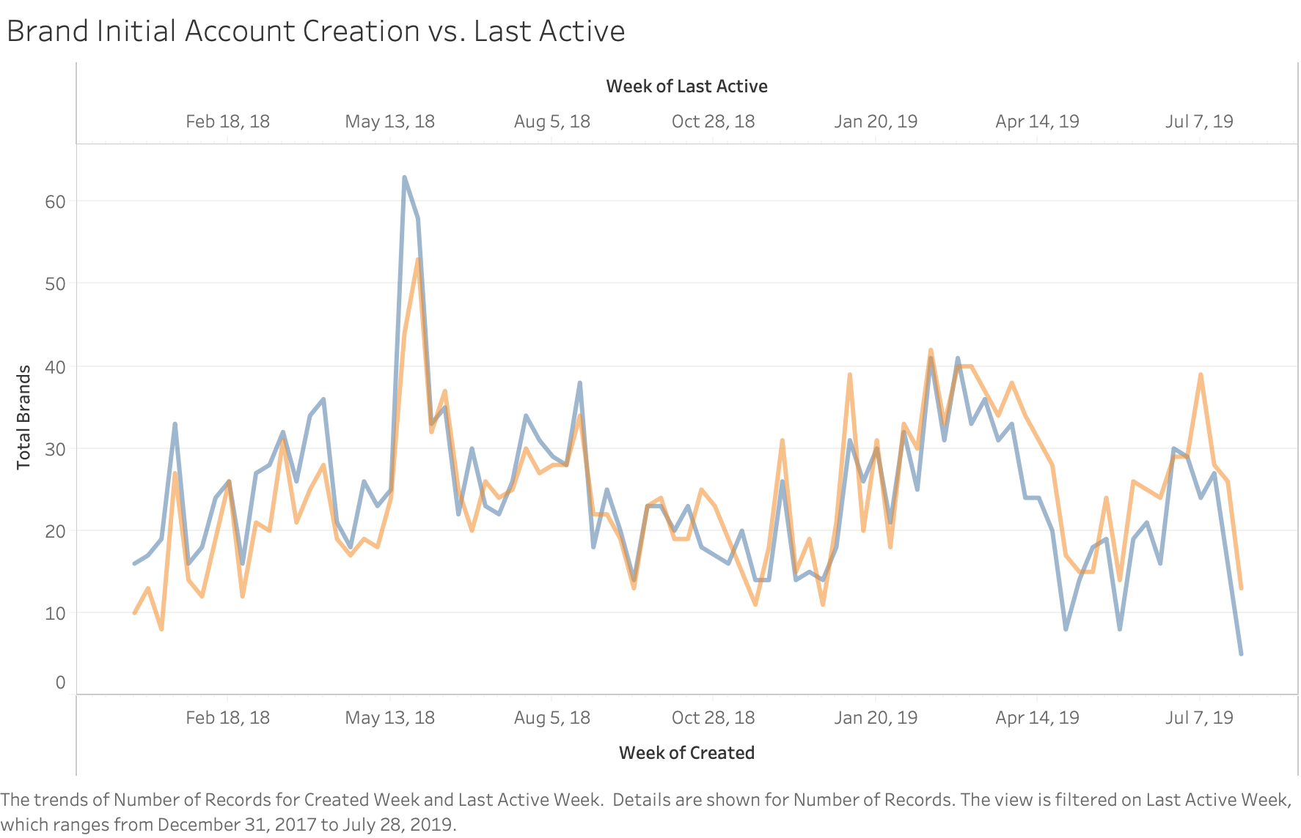

Slide 5
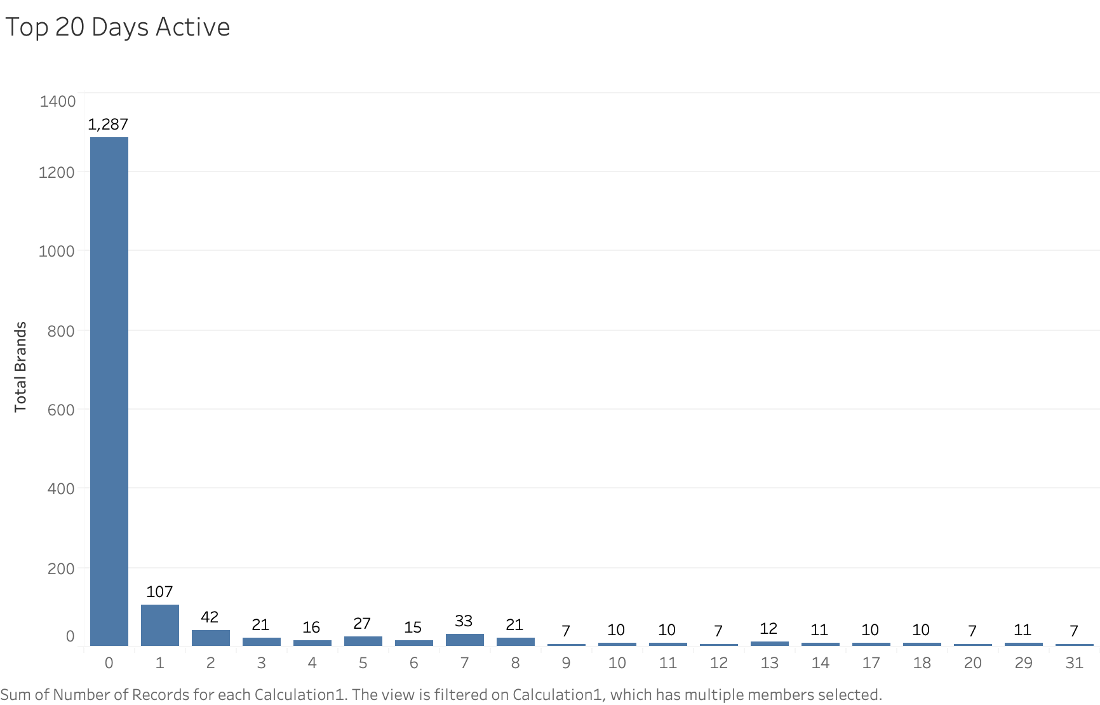

Slide 6
